Slide 1

AMAZON SALES DATA
-Shraddha Sharma

Slide 2

INTRODUCTION
We embark on a journey to uncover the secrets hidden within our Amazon sales data. By conducting an Extract-Transform-Load (ETL) analysis, we aim to unveil the sales trends month-wise, year-wise, and yearly_month-wise. Additionally, we will delve deep into the data to identify key metrics and factors influencing sales, establishing meaningful relationships between attributes. Through this exploration, we seek to optimize sales management, drive profitability, and pave the way for strategic decision-making. Let's dive into the data and unveil the insights that will shape our business trajectory .

Slide 3
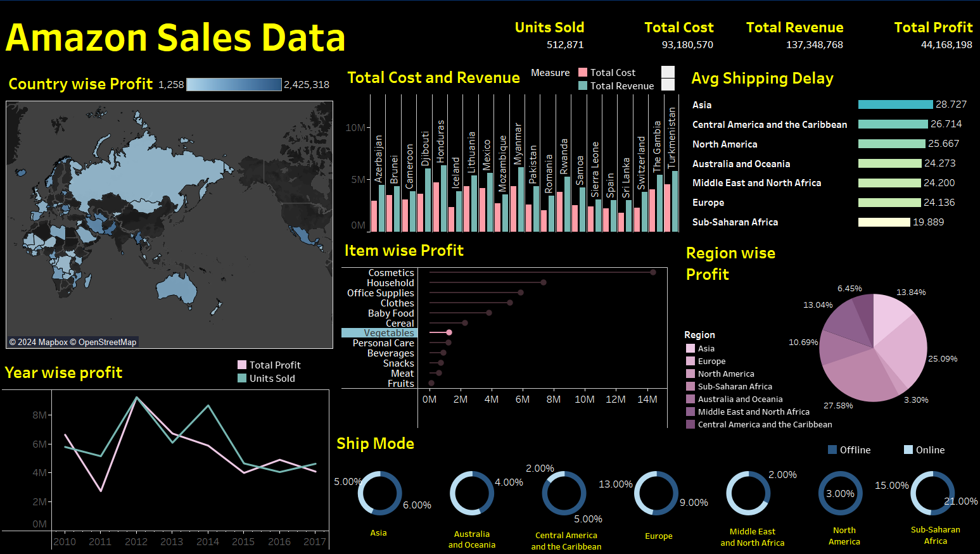

DASHBOARD

Slide 4

KPI’S
1. Unit Sold: Sold a total of 512,871 units.
2. Total Cost: Total costs amount to $931,805.70.
3. Total Revenue: The revenue generated stands at an impressive $137,348,768.
4. Total Profit: Ultimately, Secured a total profit of $44,168,198.

Slide 5

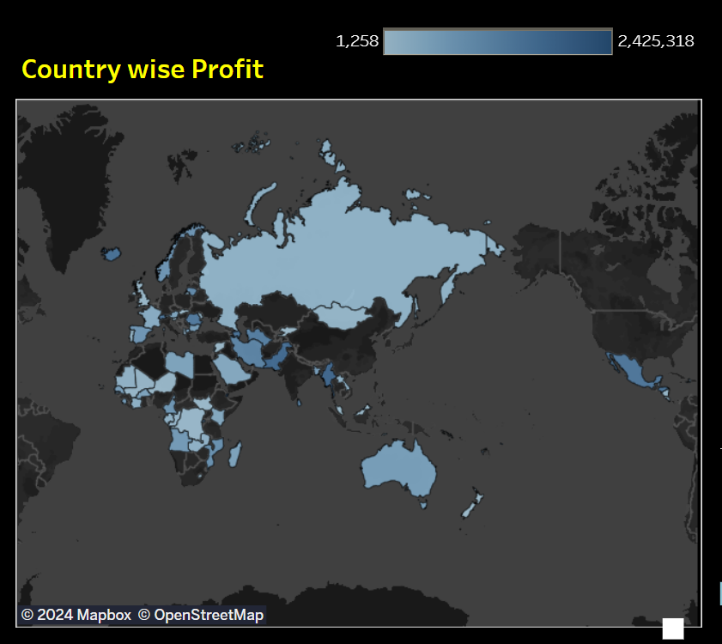
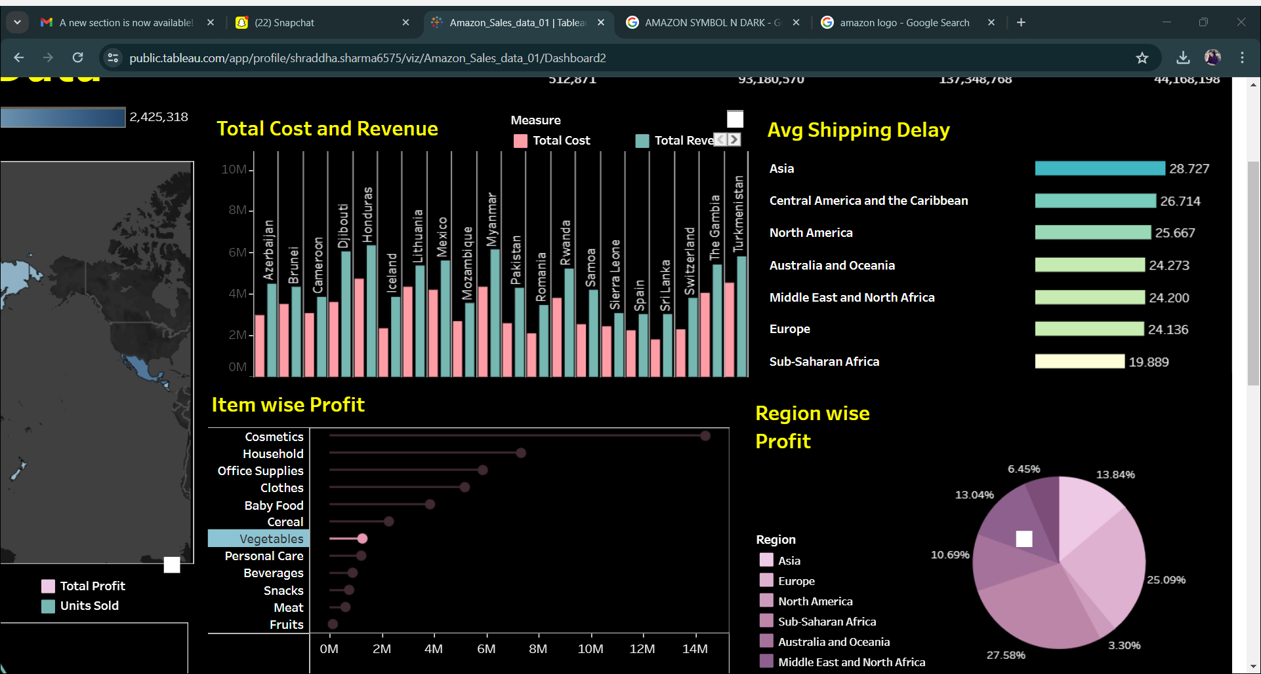
Country wise cost and revenue
COUNTRY WISE PROFIT

Slide 6
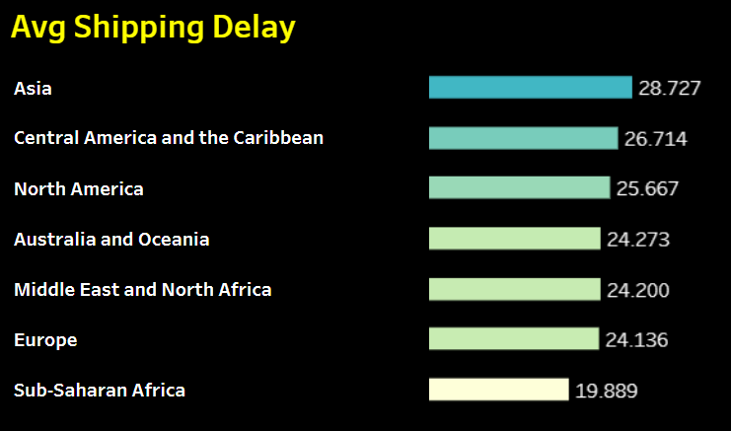
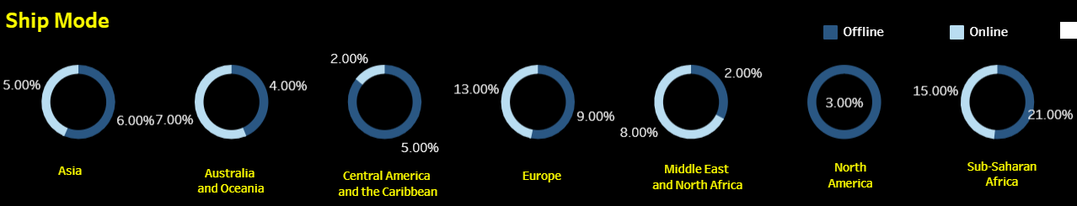
AVERAGE SHIPPING DELAY
SHIPPING
MODE

Slide 7
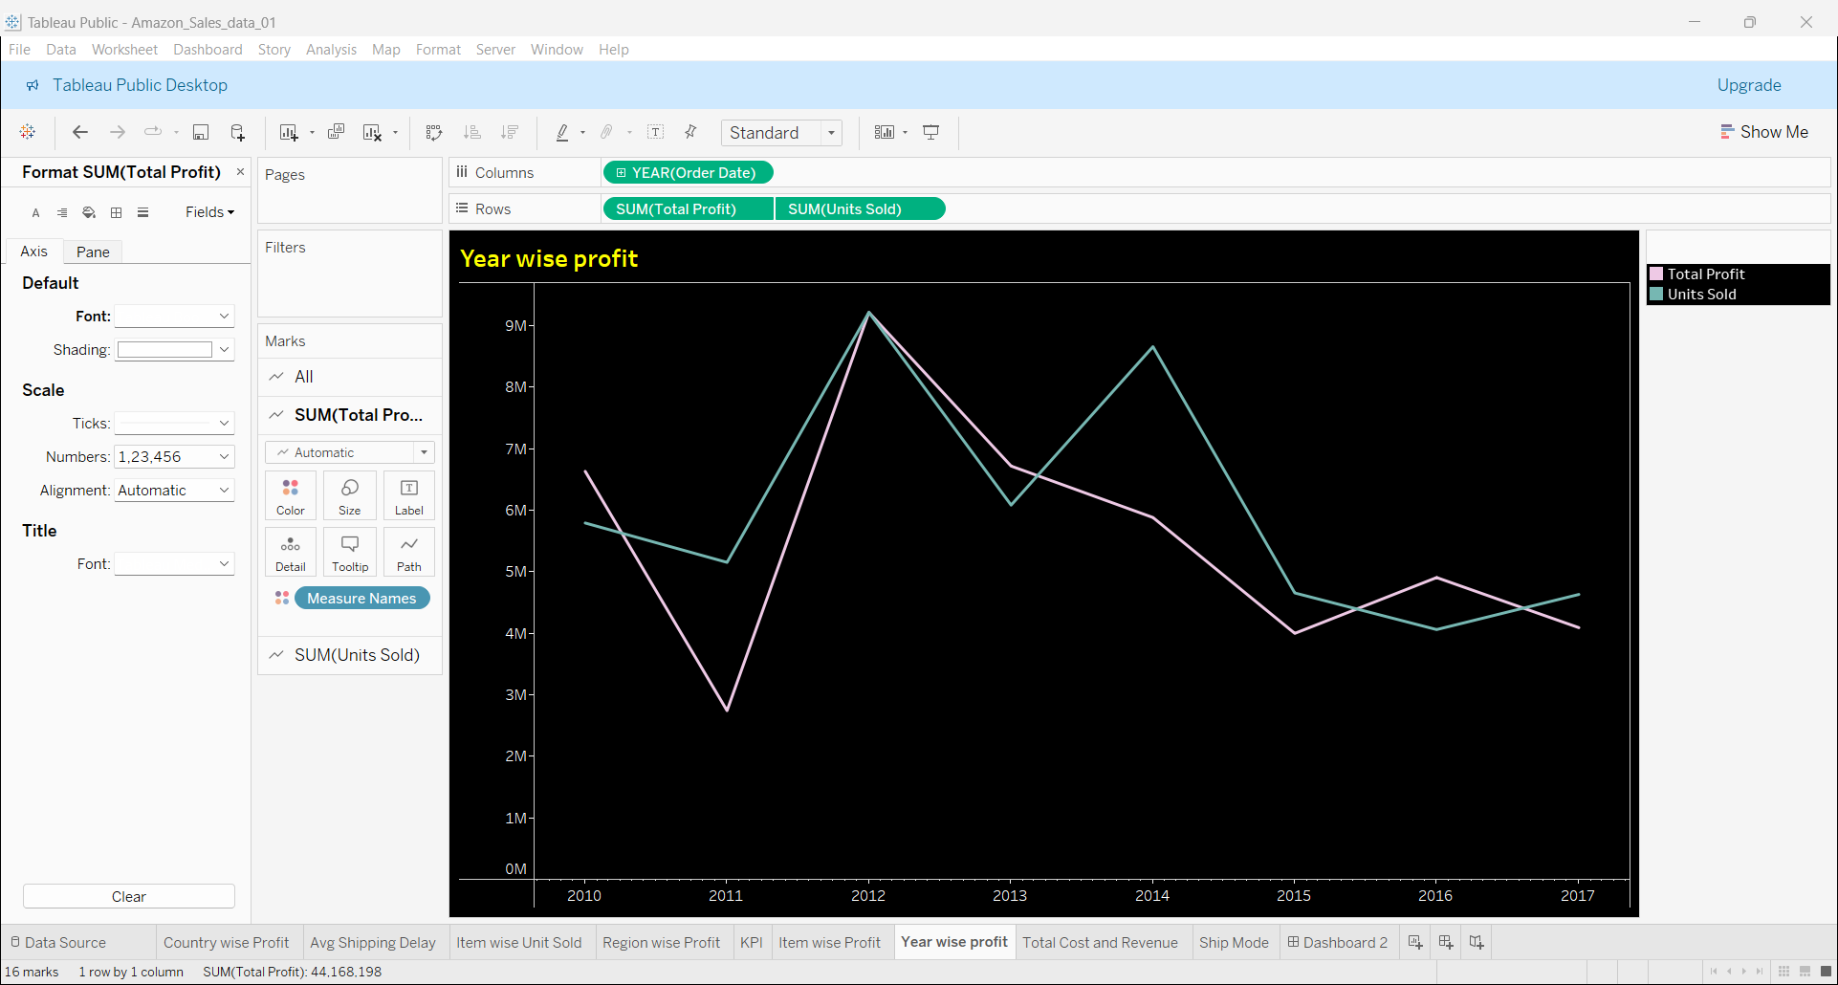
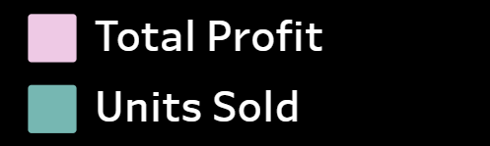
YEAR WISE
YEAR WISE PROFIT AND UNIT SOLD

Slide 8
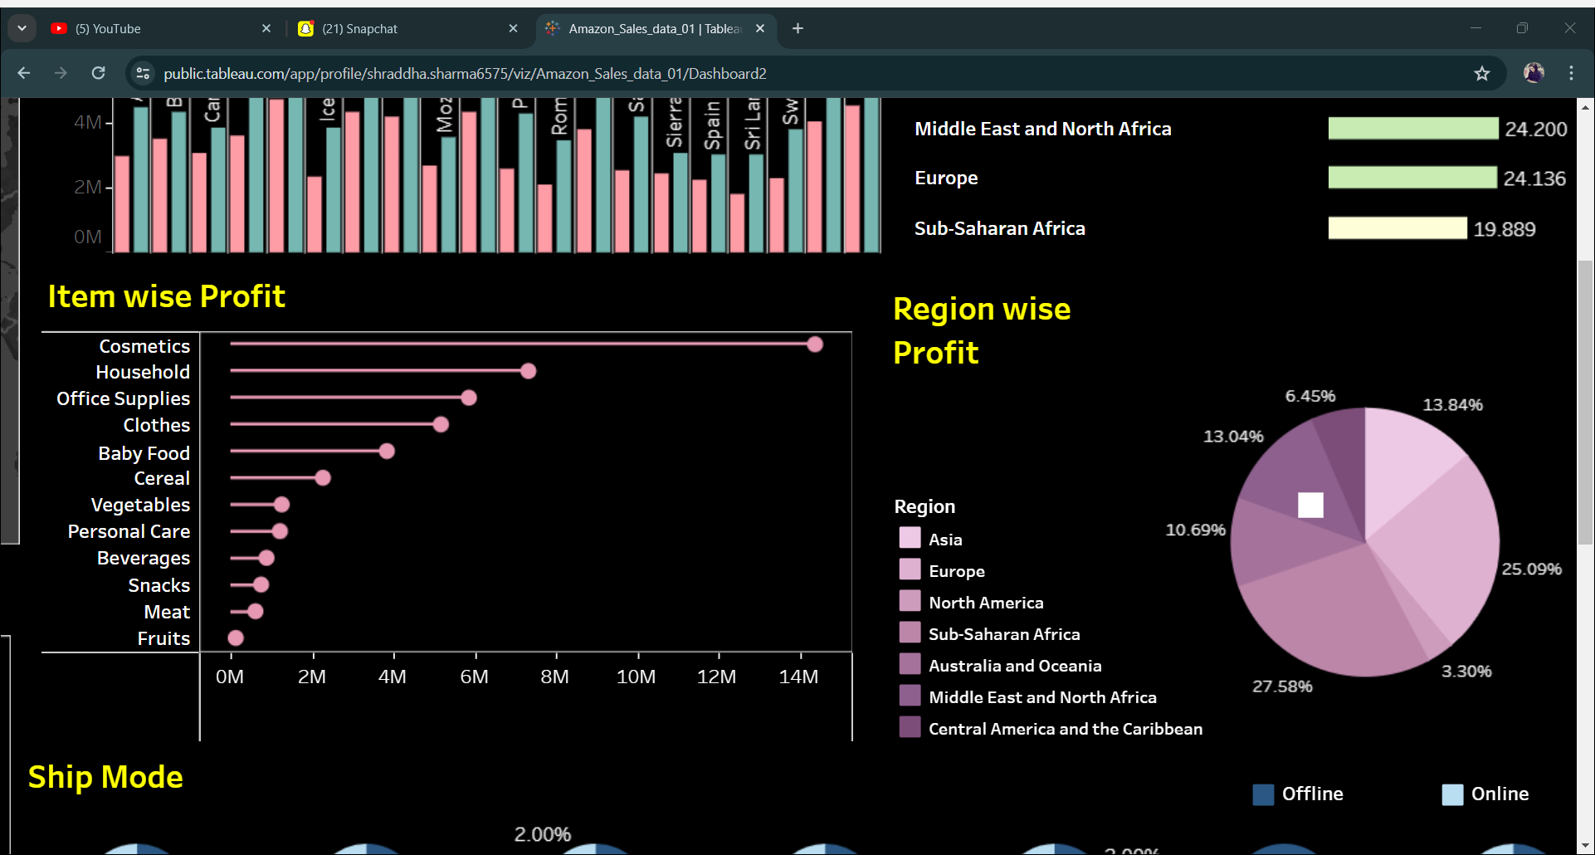
REGION WISE PROFIT
ITEM WISE PROFIT

Slide 9
ANALYSIS
1. Profit Analysis
Myanmar leads with the highest profit of $1,802,772.
Cosmetic category emerges as the most profitable.
2. Region-Wise Profit
Sub-Saharan Africa dominates with 27.58% profit share.
3. Trends Analysis
2012 stands out with the highest unit sales and profit.
Profit peaked at $9,130,010 with 979,671 units sold.
4. Shipping Insights
Asia experiences the longest shipping delays at 28.7 days.
Shipping mode preferences vary by region:
Offline mode preferred in Asia, Central America, the Caribbean, Europe, North America, and Sub-Saharan Africa.
Online mode favored in Australia, Oceania, the Middle East, and North Africa.1. Unit Sold: Sold a total of 512,871 units.

Slide 10

THANK YOU

